Slide 1
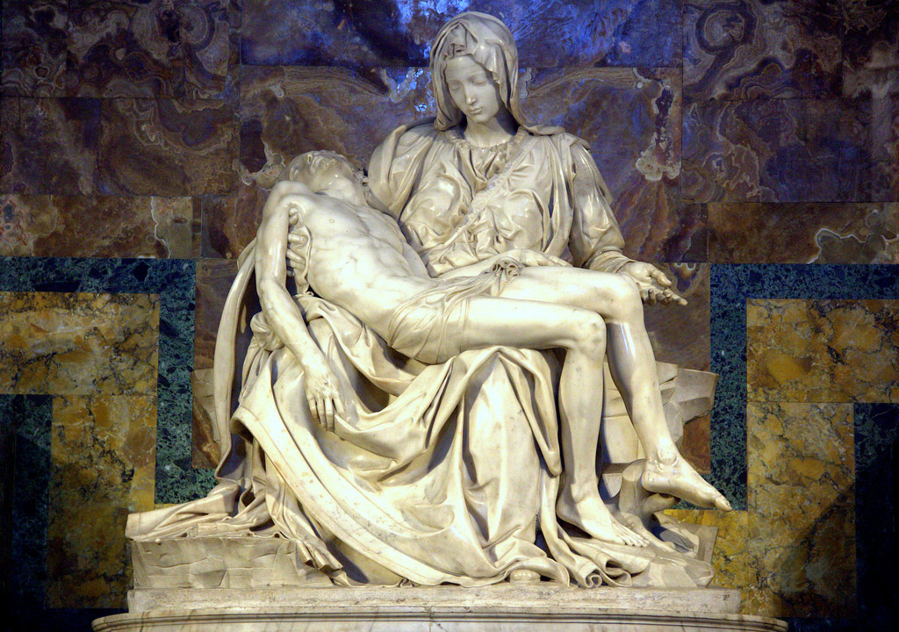
Week 4 – Sculpture, Architecture, and Crafts
ARTS 1301 Art Appreciation

Slide 2
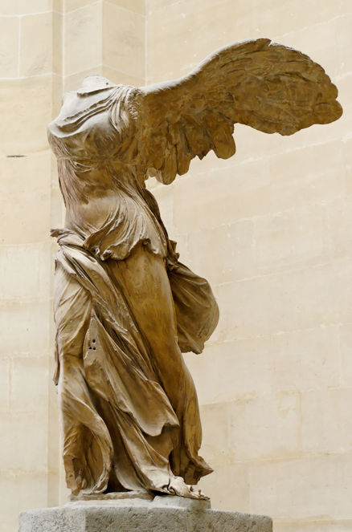
Sculpture
Sculpture is one of the oldest and most enduring of all the arts. The types of sculpture considered in this chapter—carving, modeling, casting, construction and assemblage, installation art, and earthworks—employ two basic processes: They are either subtractive or additive in nature. In subtractive processes, the sculptor begins with a mass of material larger than the finished work and removes material, or subtracts from that mass until the work achieves its finished form. Carving is a subtractive process. In additive processes, the sculptor builds the work, adding material as the work proceeds.
Winged Nike Victory of Samothrace, carved marble Hellenistic Greece, cir. 190 BC

Slide 3
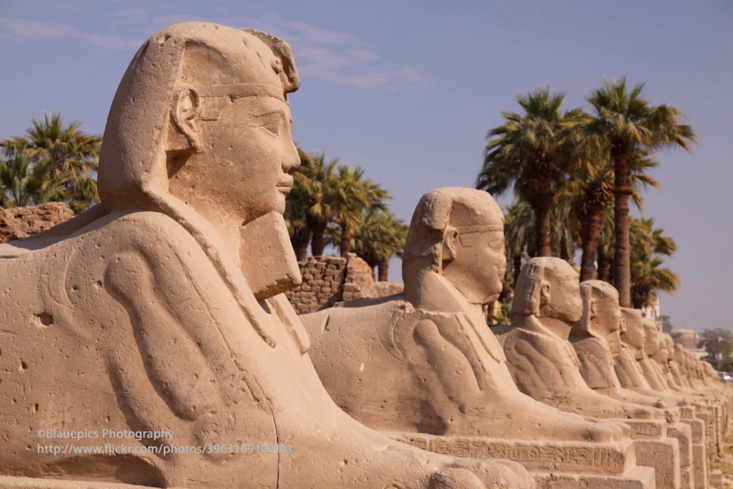
Carving
Subtractive sculture includes carving. With these terms in mind—relief sculpture, sculpture in-the-round, and environments—we can now turn to the specific methods of making sculpture. The first of these is carving, a subtractive process in which the material being carved is chipped, gouged, or hammered away from an inert, raw block of material.
Luxor, Temple, Sphinx Alley, stone sculptures
Luxor Temple east bank of the Nile River 1400 BC
.

Slide 4
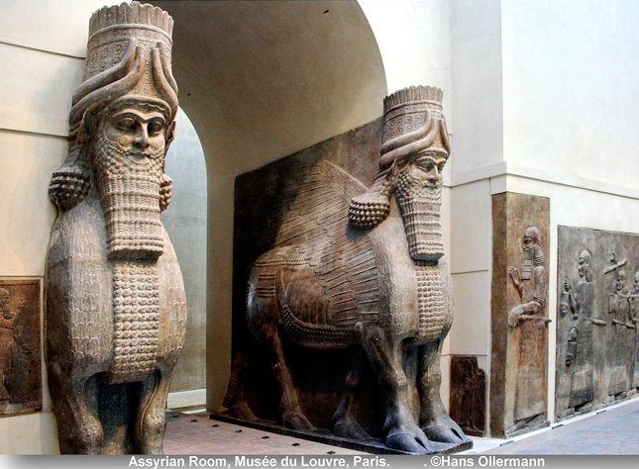
Wood and stone are the two most common carving materials. Both present problems for the artist to solve. Sculptors who work in wood must pay attention to the wood’s grain, since wood is only easily carved in the direction it grew. To work “against the grain” is to risk destroying the block. Sculptors who work in stone must take into account the different characteristics of each type of stone. Sandstone is gritty and coarse, marble soft and crystalline, granite dense and hard. Each must be dealt with differently.
Assyrian Lamassu carved stone sculptures, palace of king Sargon II at Khorsabad, 713-706 BC.

Slide 5
For Michelangelo, each stone held within it the secret of what it might become as a sculpture. “The best artist,” he wrote, “has no concept which some single marble does not enclose within its mass. . . . Taking away . . . brings out a living figure in alpine and hard stone, which . . . grows the more as the stone is chipped away.” But carving is so difficult that even Michelangelo often failed to realize his concept. In his “Atlas” Slave he has given up.
Michelangelo, “Atlas” Slave, ca. 1513–20

Slide 6
The block of stone resists Michelangelo’s desire to transform it, as if refusing to release the figure it holds enslaved within it. Yet, arguably, the power of Michelangelo’s imagination lies in his willingness to leave the figure unrealized. Atlas, condemned to bearing the weight of the world on his shoulders forever as punishment for challenging the Greek gods, is literally held captive in the stone.
Michelangelo, “Atlas” Slave, ca. 1513–20

Slide 7
Egyptian sculpture was known to the Greeks as early as the seventh century bce, and Greek sculpture is indebted to it, but the Greeks quickly evolved a much more naturalistic style. In other words, compared with the rigidity of the Egyptian figures, this Kouros, or youth is both more at ease and more lifelike. Despite the fact that his feet have been lost, we can see that the weight of his body is on his left leg, allowing his right leg to relax completely. This youth, then, begins to move.
Menkaure with a Woman, probably Khamerernebty, from valley temple of Menkaure, Giza, Dynasty 4, ca. 2480 bce

Slide 8
The sculpture begins to be animated, to portray not just the figure but also its movement. It is as if the stone has begun to come to life. Furthermore, the Kouros is much more anatomically correct than his Egyptian forebear. In fact, by the fifth century bce, the practice of medicine had established itself as a respected field of study in Greece, and anatomical investigations were commonplace. At the time that the Kouros was sculpted, the body was an object of empirical study, and its parts were understood to be unified in a single, flowing harmony.
Menkaure with a Woman, probably Khamerernebty, from valley temple of Menkaure, Giza, Dynasty 4, ca. 2480 bce

Slide 9
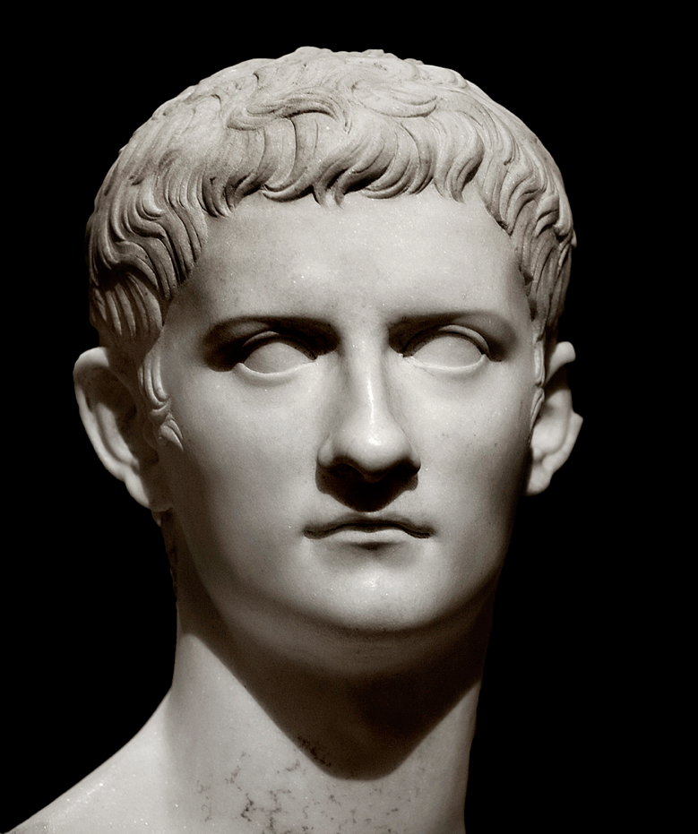
Bust of Emperor Gaius (Caligula), marble, ancient Rome cir. 37 AD
Click on image for video

Slide 10
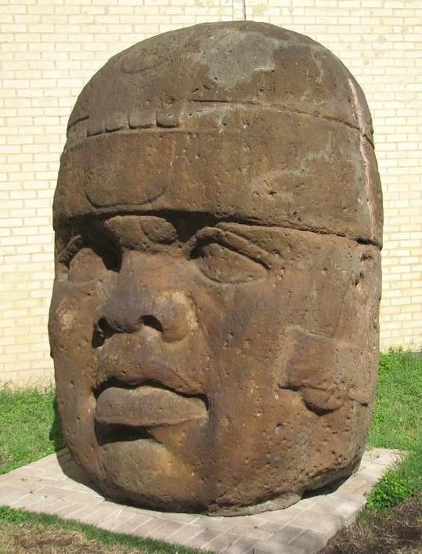
Mayan Stelle Sculpture, stone, cir. south-eastern Mesoamerica, 200 AD

Slide 11
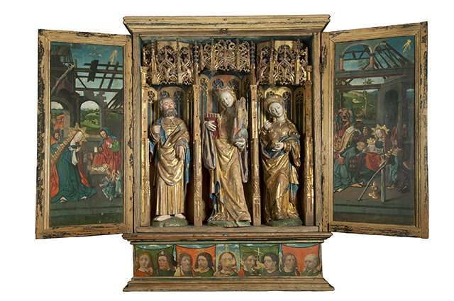
Carved wooden alterpiece, the Netherlands, middle ages
Click on image for video

Slide 12
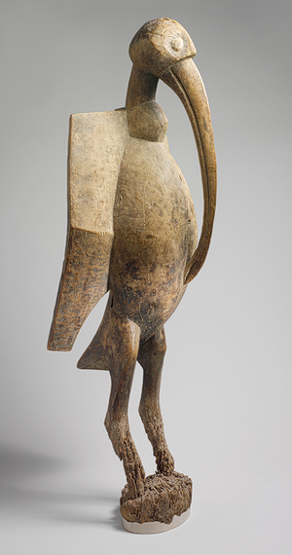
Hornbillird (Sejen), carved wood, 19th–mid-20th century. Senufo people, western Africa

Slide 13
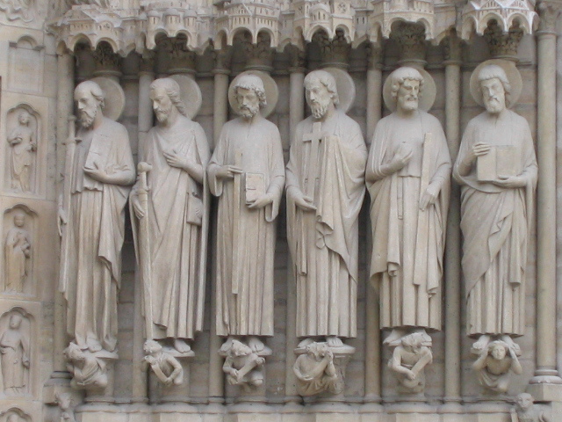
Saints, frieze sculptures on the entrance to Notre Dame Cathedral, Paris, France cir. 1250

Slide 14
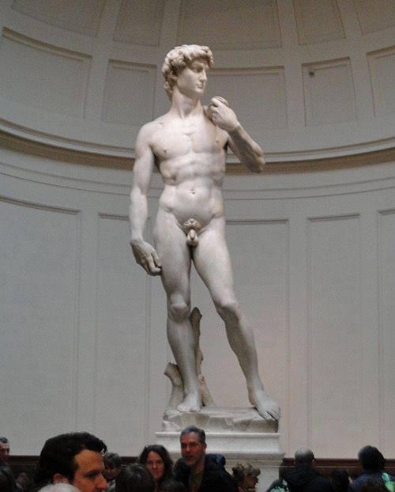
Freestanding single piece marble sculpture, David, by Michaelangelo Buonarroti, Florence, Italy 1504.
Photo by
Steven Cost
Florence, Italy
2015

Slide 15
The Pietà, Renaissance marble sculpture by Michelangelo Buonarroti 1499
Click on image for video

Slide 16
Modeling
When you pick up a handful of clay, you almost instinctively know what to do with it. You smack it with your hand, pull it, squeeze it, bend it, pinch it between your fingers, roll it, slice it with a knife, and shape it. Then you grab another handful, repeat the process, and add it to the first, building a form piece by piece. These are the basic gestures of the additive process of modeling, in which a pliant substance, usually clay, is molded.

Slide 17
Modeling
Clay, a natural material found worldwide, has been used by artists to make everything from pots to sculptures since the earliest times. Its appeal is largely due to its capacity to be molded into forms that retain their shape. Once formed, the durability of the material can be ensured by firing it—that is, baking it—at temperatures normally ranging between 1,200 and 2,700 degrees Fahrenheit in a kiln, or oven, designed especially for the process. This causes it to become hard and waterproof. We call all works made of clay ceramics.

Slide 18
Modeling
Throughout history, the Chinese have made extraordinary ceramic works, including the finest porcelains of fine, pure white clay. We tacitly acknowledge their expertise when we refer to our own “best” dinner plates as “china.” But the most massive display of the Chinese mastery of ceramic art was discovered in 1974 by well diggers who accidentally drilled into the tomb of Qin Shihuangdi, the first emperor of China In 221 bce, Qin Shihuangdi united the country under one rule and imposed order, establishing a single code of law and requiring the use of a single written language. Under his rule, the Great Wall was built, and construction of his tomb required a force of more than 700,000 men.

Slide 19
Modeling
Qin Shihuangdi was buried near the central Chinese city of Xian, or Chin (the origin of the name China), and his tomb contained more than 6,000 life-size, and extraordinarily lifelike, ceramic figures of soldiers and horses, immortal bodyguards for the emperor. More recently, clerks, scribes, and other court figures have been discovered, as well as a set of magnificent bronze horses and chariots.
Tomb of Emperor Qin Shihuangdi, 221–206 bce

Slide 20
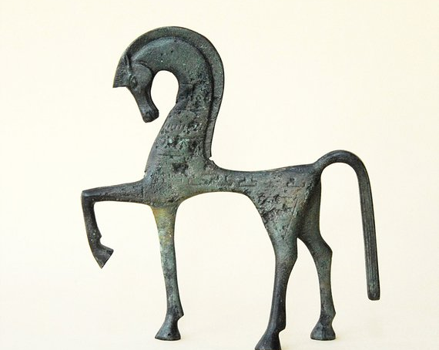
Casting
Casting employs a mold into which some molten material is poured and allowed to harden. It is an invention of the Bronze Age (beginning in approximately 2500 bce), when it was first used to make various utensils by simply pouring liquid bronze into open-faced molds. The technology is not much more complicated than that of a gelatin mold. You pour gelatin into the mold and let it harden.
Greek Geometric Metal Equine Sculpture, cast bronze
circa 550 BC

Slide 21
Casting
When you remove the gelatin, it is shaped like the inside of the mold. Small figures made of bronze are similarly produced by making a simple mold of an original modeled form, filling the mold with bronze, and then breaking the mold away.
As the example of gelatin demonstrates, bronze is not the only material that can be cast. In the kingdom of Benin, located in southern Nigeria, on the coastal plain west of the Niger River, brass casting reached a level of extraordinary accomplishment as early as the late fourteenth century. Brass, which is a compound composed of copper and zinc, is similar to bronze but contains less copper and is yellower in color. When, after 1475, the people of Benin began to trade with the Portuguese for copper and brass, an explosion of brass casting occurred. A brass head of an oba, or king of a dynasty, which dates from the eighteenth century is an example of a cast brass sculpture

Slide 22
When an oba dies, one of the first duties of the new oba—the old oba’s son—is to establish an altar commemorating his father and to decorate it with newly cast brass heads. The heads are not portraits. Rather, they are generalized images that emphasize the king’s coral-bead crown and high bead collar, the symbols of his authority. The head has a special significance in Benin ritual.
Brass and iron, height 13¹⁄₈ in. Metropolitan Museum of Art, New York.

Slide 23
Because bronze is so soft and malleable, cast bronze pieces can be joined to create large-scale sculpture. The pieces are either pounded together with a hammer, the procedure used in Greek times, or welded, the more usual procedure today. Auguste Rodin’s towering Burghers of Calais was produced using the latter technique.
Auguste Rodin, The Burghers of Calais, 1884–85
.

Slide 24
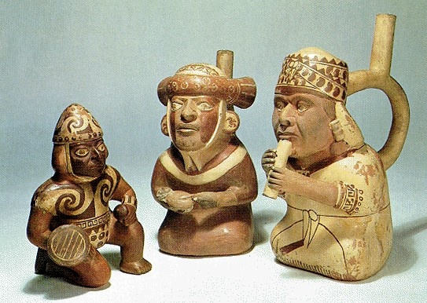
Ceramic sculptures, Peru, cir. 1200 AD

Slide 25
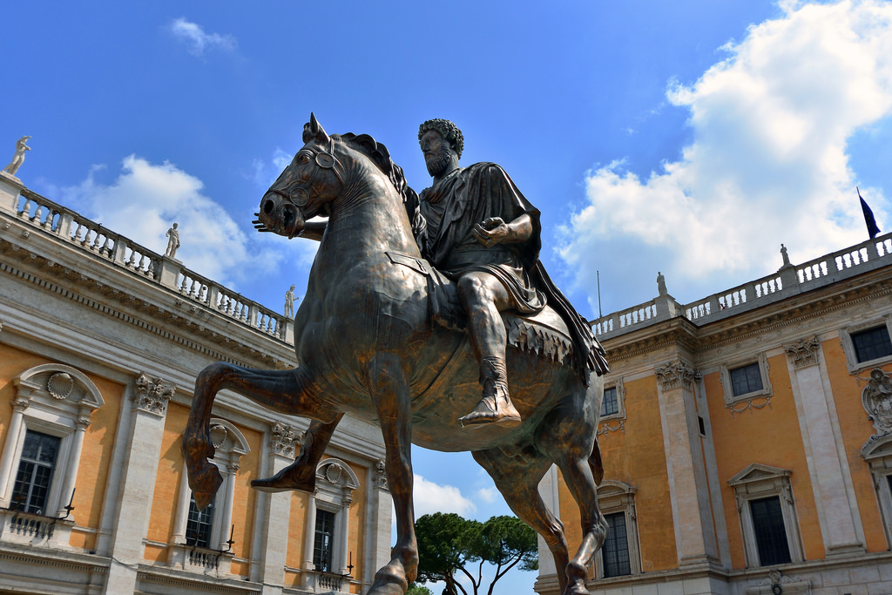
Marcus Aurelius, cast bronze, ancient Rome 175 AD photo by Steven Cost
Click on image for video

Slide 26
Assemblage
To the degree that they are composed of separately cast pieces later welded or grouped together, works like Rodin’s Burghers of Calais and Ahearn’s Homage to the People of the South Bronx are examples of assemblage, the process of bringing individual objects or pieces together to form a larger whole. But as a process, assemblage is more often associated with the transformation of common materials into art in which the artist brings together parts found in the world and puts them together in a new composition.

Slide 27
For instance, Louise Nevelson’s Sky Cathedral (Fig. 12-17) is a giant assemblage of wooden boxes, woodworking remnants and scraps, and found objects. It is entirely frontal and functions like a giant high-relief altarpiece—hence its name—transforming and elevating its materials to an almost spiritual dimension. Nevelson manages to make a piece of almost endless variety and difference appear unified and coherent.
Wood, painted black, 9 ft. 7 in. × 11 ft. 3 in. × 28 in. Albright-Knox Art Gallery, Buffalo, New York.

Slide 28
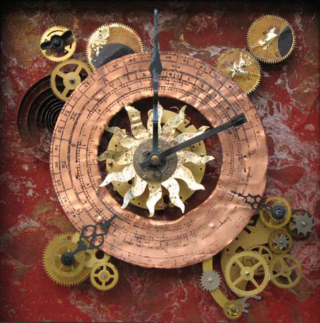
Calendarium, assemblage by Steven Cost, 2014
Click on image for video

Slide 29
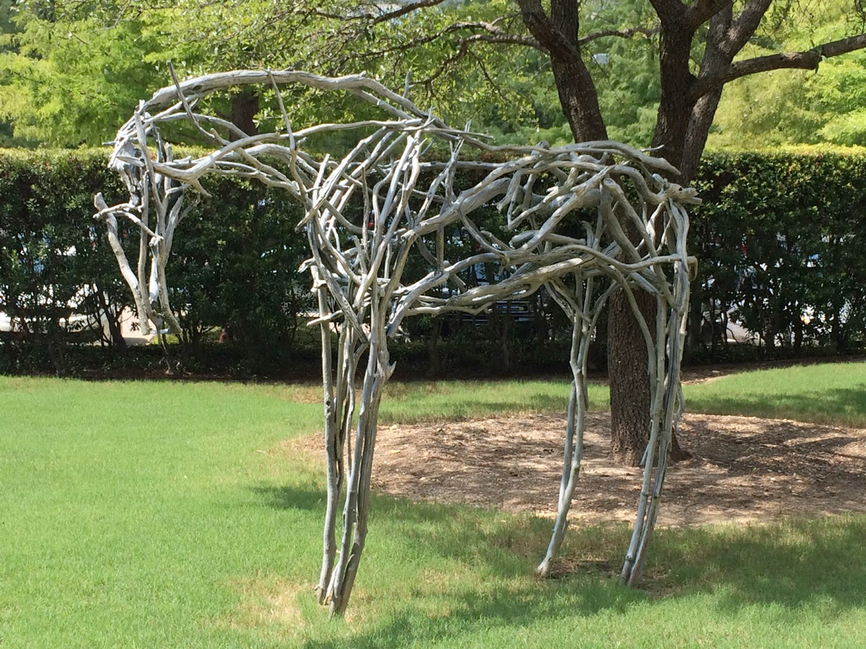
Horse, assemblage of driftwood , Ft. Worth Museum of Modern Art, 2014

Slide 30
Installations
Obviously, the introduction of any work of art into a given space changes it. Encountered in an environment where the viewer expects to see works of art—in a museum or gallery—the work might surprise or, even, cause us to reevaluate the space itself. But in other kinds of space—in the streets or landscape—to suddenly encounter a work of art can be transformative, causing us to rethink just what our expectations for art might be.
Stainless steel, 33 × 66 × 42 ft. Millennium Park, Chicago.

Slide 31
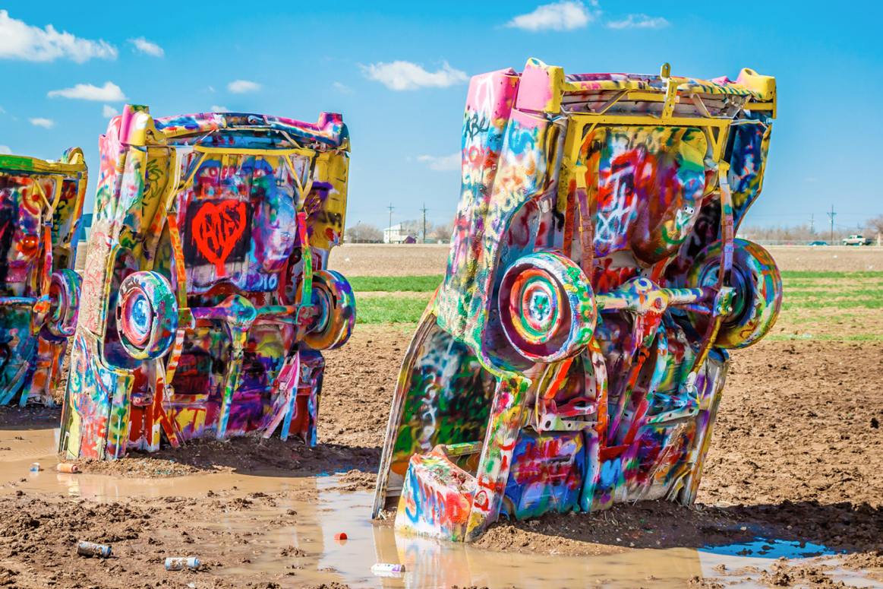
Click on image for video
Ant Farm, Cadillac Ranch, Amarillo, Texas 1974
Installation commissioned by Stanley Marsh 3

Slide 32
Earthworks
The larger a work, the more our visual experience of it depends on multiple points of view. Since the late 1960s, one of the focuses of modern sculpture has been the creation of large-scale out-of-doors environments, generally referred to as earthworks. Robert Smithson’s Spiral Jetty is a classic example of the medium. Stretching into the Great Salt Lake at a point near the Golden Spike monument, which marks the spot where the rails of the first transcontinental railroad were joined, Spiral Jetty literally is landscape. Made of mud, salt crystals, rocks, and water, it is a record of the geological history of the place. But it is landscape that has been created by man. The spiral form makes this clear. The spiral is one of the most widespread of all ornamental and symbolic designs on earth.

Slide 33
Installation
In Egyptian culture, it designated the motion of cosmic forms and the relationship between unity and multiplicity, in a manner similar to the Chinese yin and yang. The spiral is, furthermore, found in three main natural forms: expanding like a nebula, contracting like a whirlpool, or ossified like a snail’s shell. Smithson’s work suggests the way in which these contradictory forces are simultaneously at work in the universe. Thus the Jetty gives form to the feelings of contradiction he felt as a contemporary inhabitant of his world. Motion and stasis, expansion and contraction, life and death, all are simultaneously suggested by the 1,500-foot coil, the artist’s creation extending into the Great Salt Lake, America’s Dead Sea

Slide 34
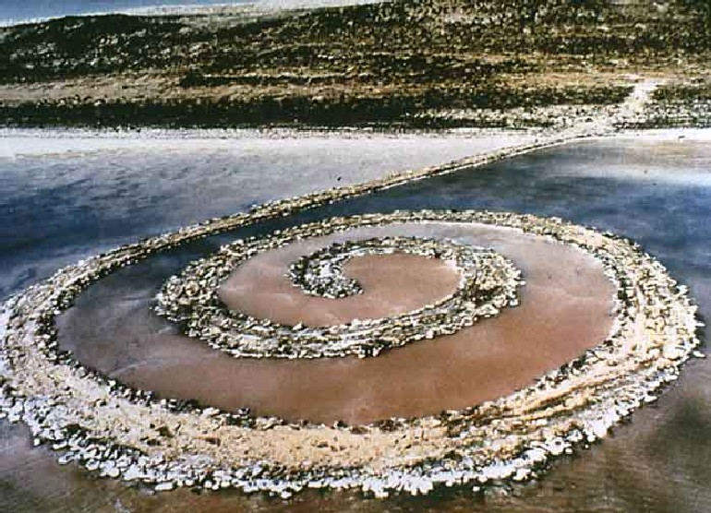
Installation
Robert Smithson, Spiral Jetty, April 1970

Slide 35
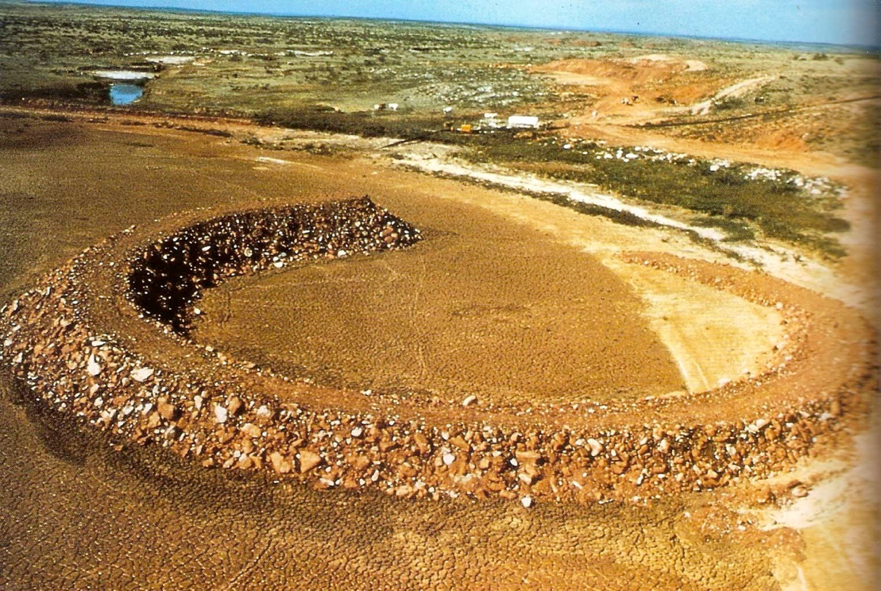
obert Smithson, Spiral Jetty, 1970
Robert Smithson, Amarillo Ramp, Amarillo, Texas 1973
Click on image for video

Slide 36
Spiral Jetty was directly inspired by the Great Serpent Mound, an ancient Native American earthwork in Adams County, Ohio (Fig. 12-28). Built by the Hopewell culture sometime between 600 bce and 200 ce, it is nearly a quarter of a mile long. And though almost all other Hopewell mounds contain burials, this one does not. Its “head” consists of an oval enclosure that may have served some ceremonial purpose, and its tail is a spiral. The spiral would, in fact, become a favorite decorative form of the later Mississippian cultures. The monumental achievement of Smithson’s Spiral Jetty, made with dump trucks and bulldozers, is dwarfed by the extraordinary workmanship and energy that must have gone into the construction of this prehistoric earthwork.

Slide 37
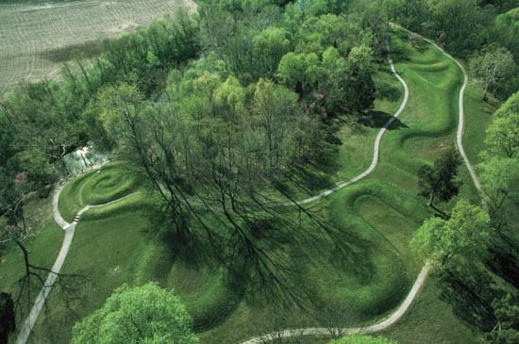
Great Serpent Mound, Native American ancient earthwork, Ohio, USA cir. 1070 AD
Click on image for video

Slide 38
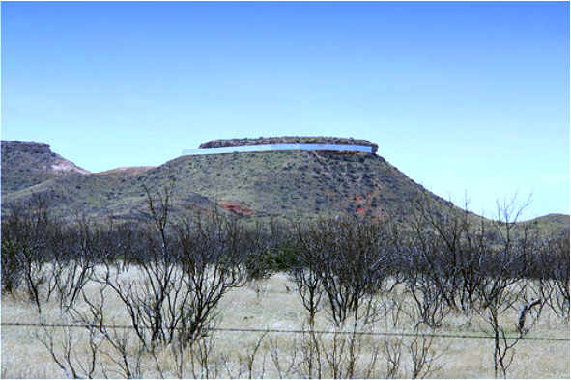
obert Smithson, Spiral Jetty, 1970
Commissioned by Stanley Marsh 3, Floating Measa,
Amarillo, Texas 1981
Click on image for video

Slide 39
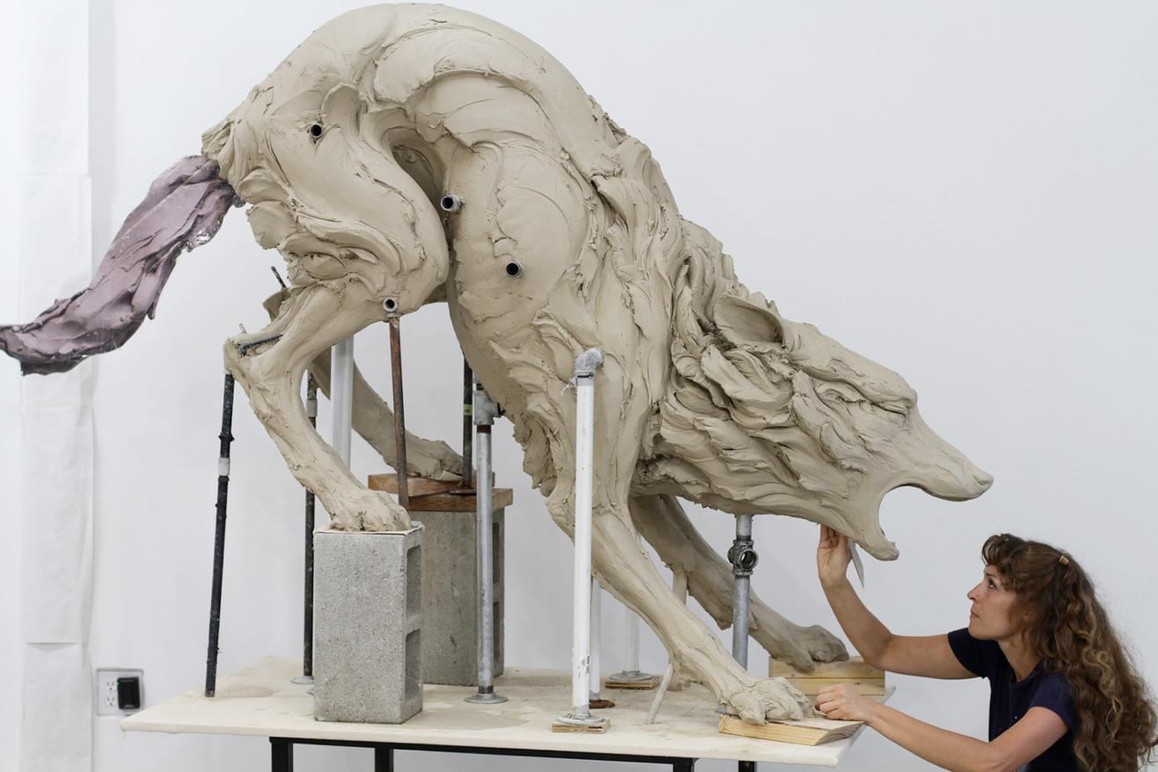
Beth Cavener, clay modeling and ceramic sculpture
Click on image for video

Slide 40
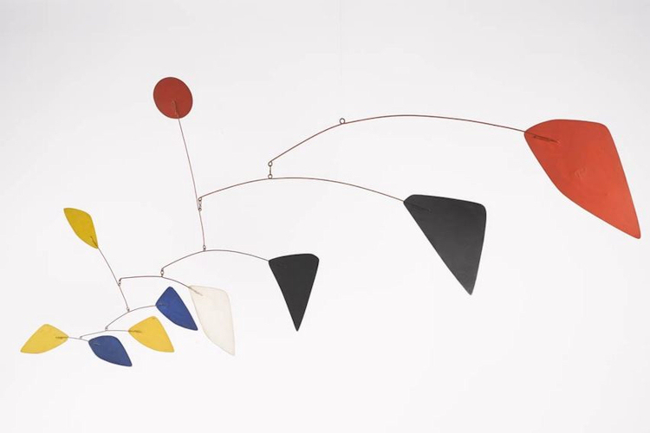
Mariposa, mobile, kinetic art, Alexander Calder 1960
Click on image for video

Slide 41
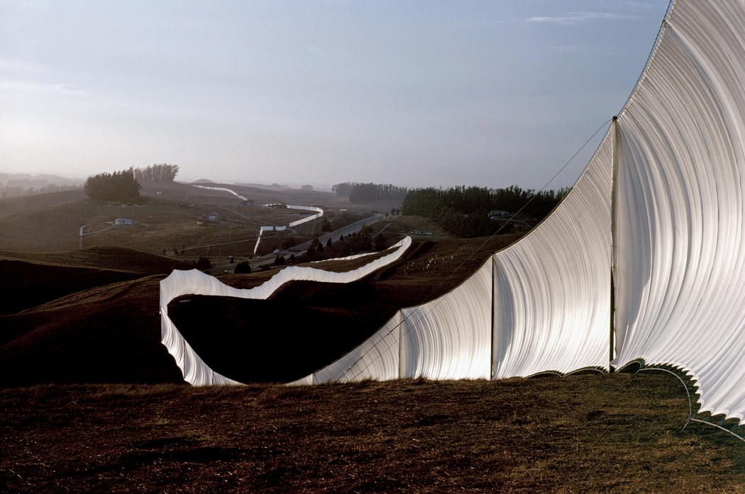
Running Fence, Christo and Jeanne Claude, Sonoma and Marin Counties, California 1972-76
Click on image for video

Slide 42
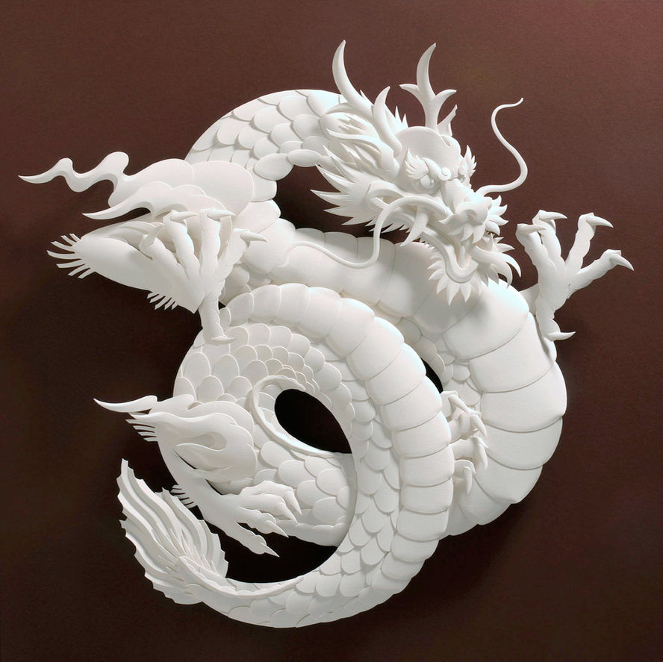
Dragon, by Jeff Nishinaka, paper sculpture, Angeles 2016
Click on image for video

Slide 43
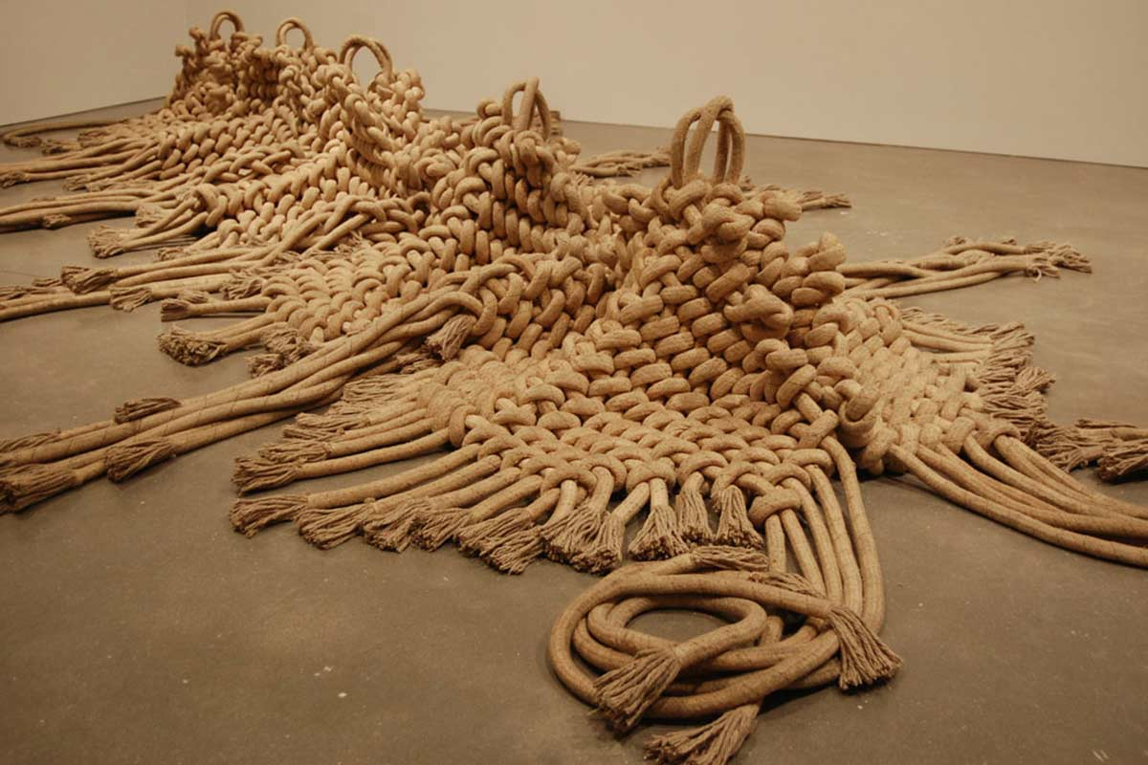
Unity, Fiber arts installation, Mary Weiss, London
Click on image for video

Slide 44
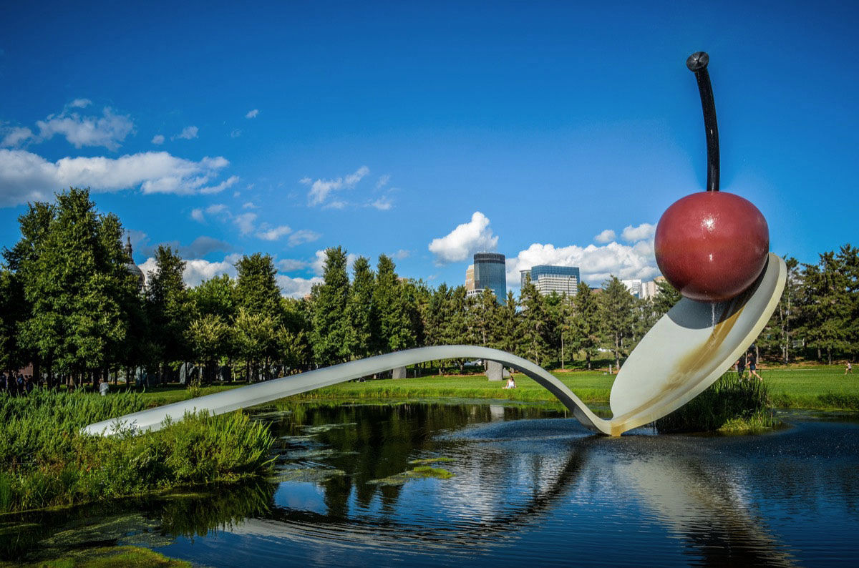
Spoonbridge and Charry, Claes Oldenburg, Pop Art sculpture, Walker Art Center, Minneapolis, Minnesota, 1985

Slide 45
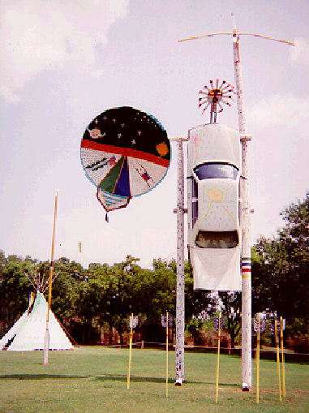
Warrior, Thomas Palmer, Kiowa, Pop Art Assemblage, TV dish and Mercedes, 30 feet tall, Southern Plains Museum, Anadarko, Okla.

Slide 46
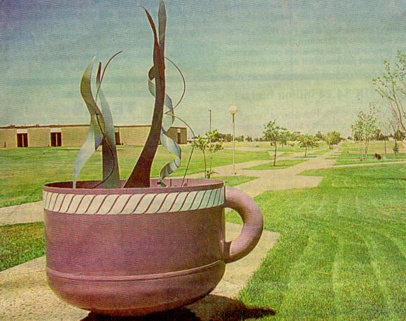
Cup of Java, Dash Danner, Amarillo College East Campus ,
Pop Art Assemblage 1992

Slide 47
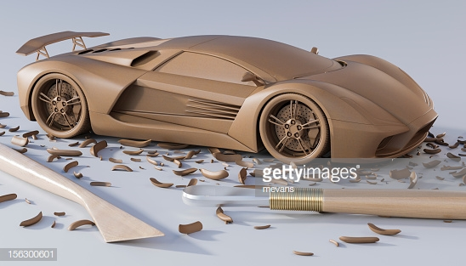
, Concept automobile design sculpting
Click on image for video

Slide 48
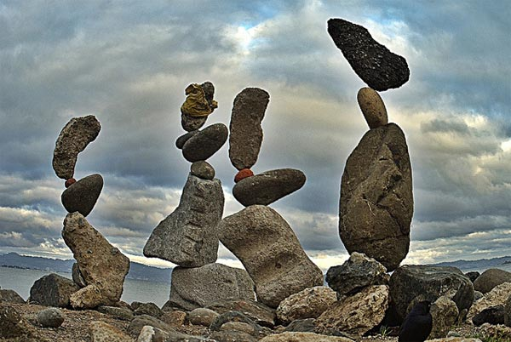
Meditative rock stacking
Click on image for video

Slide 49
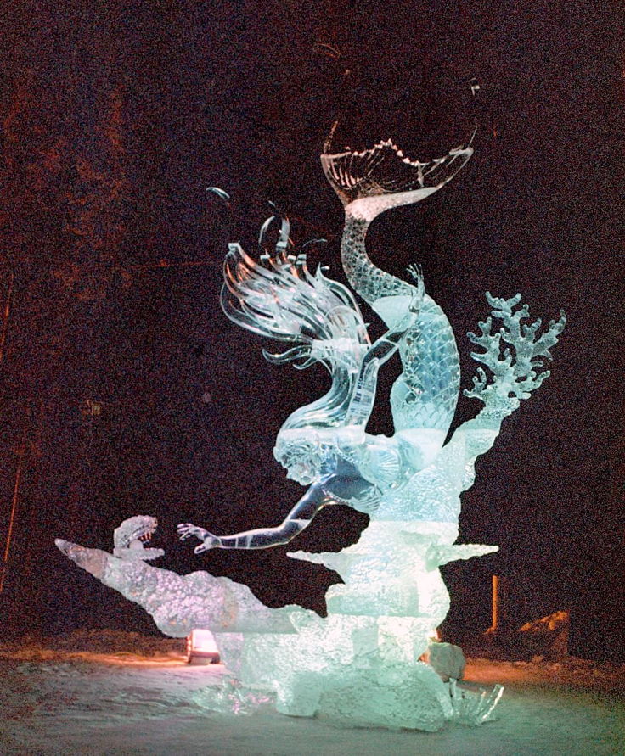
Ice sculpting
Click on image for video

Slide 50
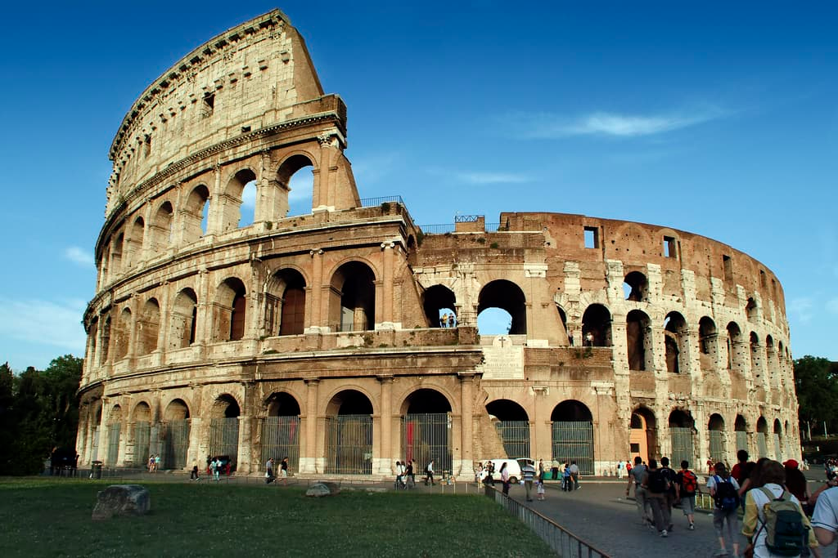
MAKING ART Architecture
ARTS 1301 Art Appreciation

Slide 51
n the early 1980s, the president of France, François Mitterrand, embarked on a program of Grands Projets designed to transform and revitalize the French capital, Paris. Among the most important of these was a plan to expand the Louvre Museum by creating a central entryway, in the middle of the Cour Napoléon, the courtyard contained by the Old Louvre palace, to the east, and two later wings, the Richelieu wing to the north, and the Denon wing to the south, the latter completed by Louis XIII in the early seventeenth century but begun by Catherine de Medici in 1550.

Slide 52
American architect I. M. Pei was awarded the commission. His plan was simple but elegant. The entire Cour Napoléon and the Place du Carrousel to its west were excavated, creating a vast underground visitor’s center with entries on three sides into the collections and surmounted, at the center of the Cour Napoléon, by Pei’s today iconic shimmering glass pyramid pyramid is distinctly contemporary, but it adds just one more historical layer to a building that originated in the thirteenth century as a defensive fortress and was subsequently enlarged by major additions that incorporated, in succession, Renaissance, Baroque, and Neoclassical styles.
I. M. Pei, Glass Pyramid, Cour Napoléon, Louvre, Paris, 1983–89; in front of the 17th-century Denon wing of the museum

Slide 53
The architecture of the vast majority of early civilizations was designed to imitate natural forms. The significance of the pyramids of Egypt (Fig. 14-2) is the subject of much debate, but their form may well derive from the image of the god Re, who in ancient Egypt was symbolized by the rays of the sun descending to earth. A text in one pyramid reads: “I have trodden these rays as ramps under my feet.” As one approached the mammoth pyramids, covered in limestone to reflect the light of the sun, the eye was carried skyward to Re, the Sun itself, who was, in the desert, the central fact of life.
Pyramids of Menkaure (ca. 2470 bce), Khafre (ca. 2500 bce), and Khufu (ca. 2530 bce)
Original height of Pyramid of Khufu 480 ft., length of each side at base 755 ft.

Slide 54
The Anasazi cliff dwelling known as Spruce Tree House (Fig. 14-4) at Mesa Verde National Park in southwestern Colorado reflects a similar relation between humans and their environment.
The Anasazi lived in these cliffside caves for hundreds, perhaps thousands, of years. The cave provided security, but to live there was also to be closer to the people’s origin and, therefore, to the source of their strength.
Mesa Verde, Spruce Tree House, ca. 1200–1300 ce. Courtyard formed by restoration of the roofs over two underground kivas.

Slide 55
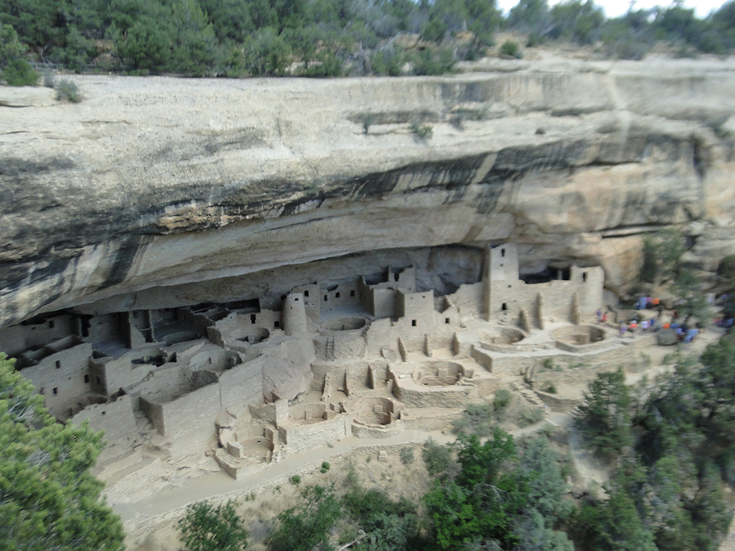
For unknown reasons, the Anasazi abandoned their cliff dwellings in about 1300 ce. One possible cause was a severe drought that lasted from 1276 to 1299. It is also possible that disease, a shortened growing season, or war with Apache and Shoshone tribes caused the Anasazi to leave the highland mesas and migrate south into Arizona and New Mexico.
Cliff Palace, Mesa Verde ancestral indians cliff dwelling, Southwest Colorado, USA cir 1260 AD

Slide 56
In the face of climate change, architects have been challenged to engage in a different, more environmentally friendly and sustainable, practice—­so-called green architecture.
Obie Bowman, Brunsell Residence, Sea Ranch, California, 1987

Slide 57
The basic technological challenge faced by architecture since the earliest times is to construct upright walls and put a roof over the empty space they enclose. Walls may employ one of two basic structural systems: the shell system, in which one basic material provides both the structural support and the outside covering of the building, and the skeleton-and-skin system, which consists of a basic interior frame, the skeleton, that supports the more fragile outer covering, the skin.
In a building that is several stories tall, the walls or frame of the lower floors must also support the weight of the upper floors. The ability of a given building material to support weight is thus a determining factor in how high the building can be. The walls or frame also support the roof.

Slide 58
The span between the elements of the supporting structure—between, for instance, stone walls, columns, or steel beams—is determined by the tensile strength of the roof material. Tensile strength is the ability of a building material to span horizontal distances without support and without buckling in the middle: The greater the tensile strength of a material, the wider its potential span. Almost all technological advances in the history of architecture depend on either the invention of new ways to distribute weight or the discovery of new materials with greater tensile strength. We begin our survey with the most basic technology and move forward to the most advanced.

Slide 59
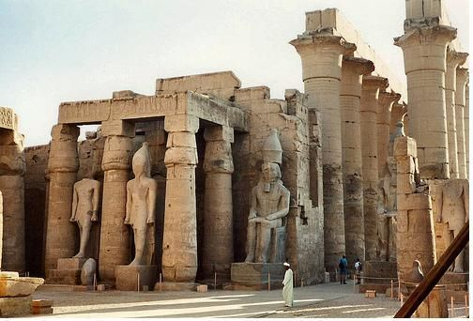
Egyptian temple of Luxor, Egypt cir. 1400 BC

Slide 60
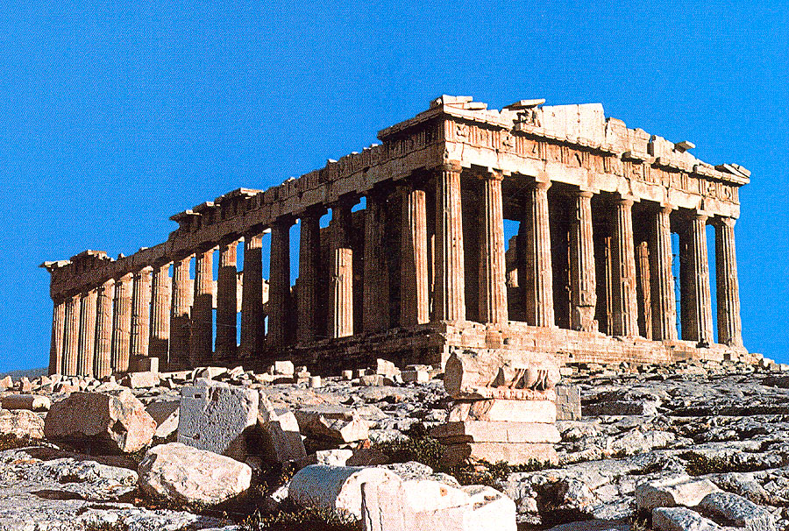
Parthenon, Temple of Athena, Athens, Greece cir. 432 BC

Slide 61
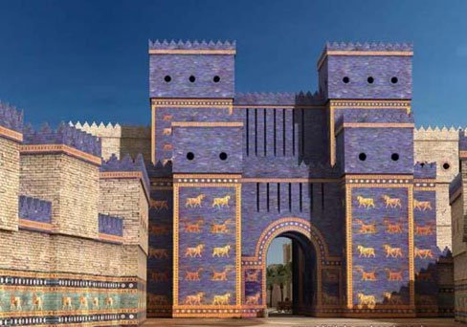
Gate of Ishtar, entrance to the ancient city of Babylon, Iraq (stracture removed to Berlin, Germany) cir. 432 BC

Slide 62
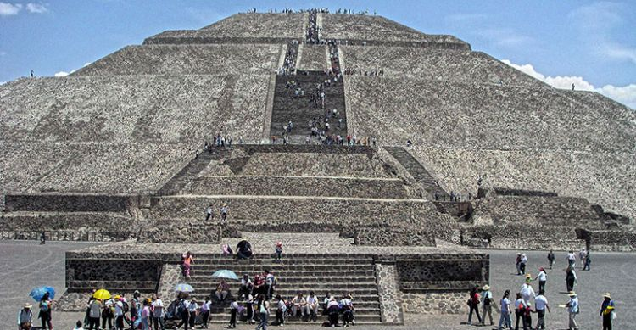
Teotihuacan pyramid, central Mexico completed 100 BC

Slide 63
Roman Colosseum, Rome, Italy cir. 80 BC

Slide 64
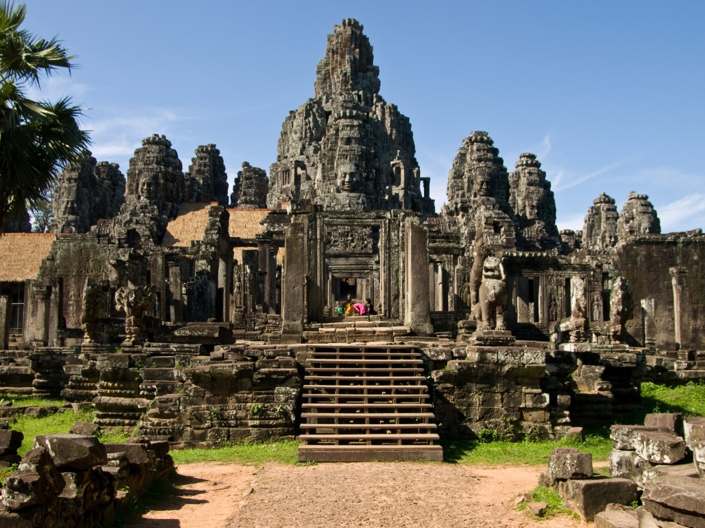
Temple of Angko Wat, Cambodia cir. 1100 AD

Slide 65
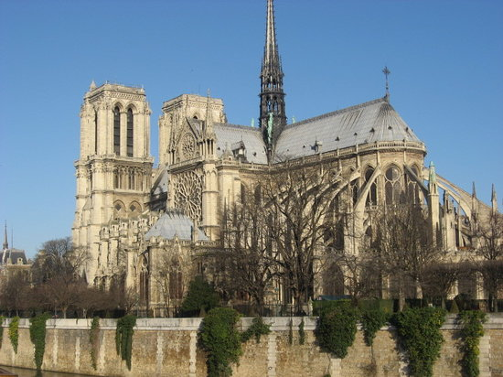
Notre Dame Cathedral, Paris, France completed 1260 AD

Slide 66
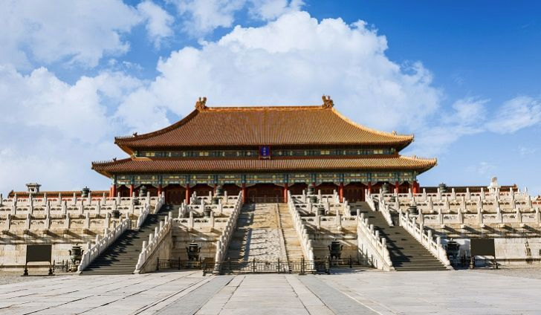
Forbidden City, Beijing, China, completed 1420 AD

Slide 67
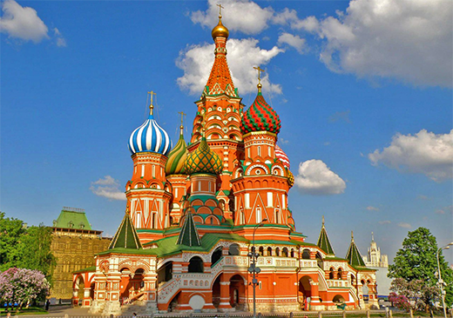
Saint Basil”s Cathedral, Moscow, Russia,
completed 1561 AD

Slide 68
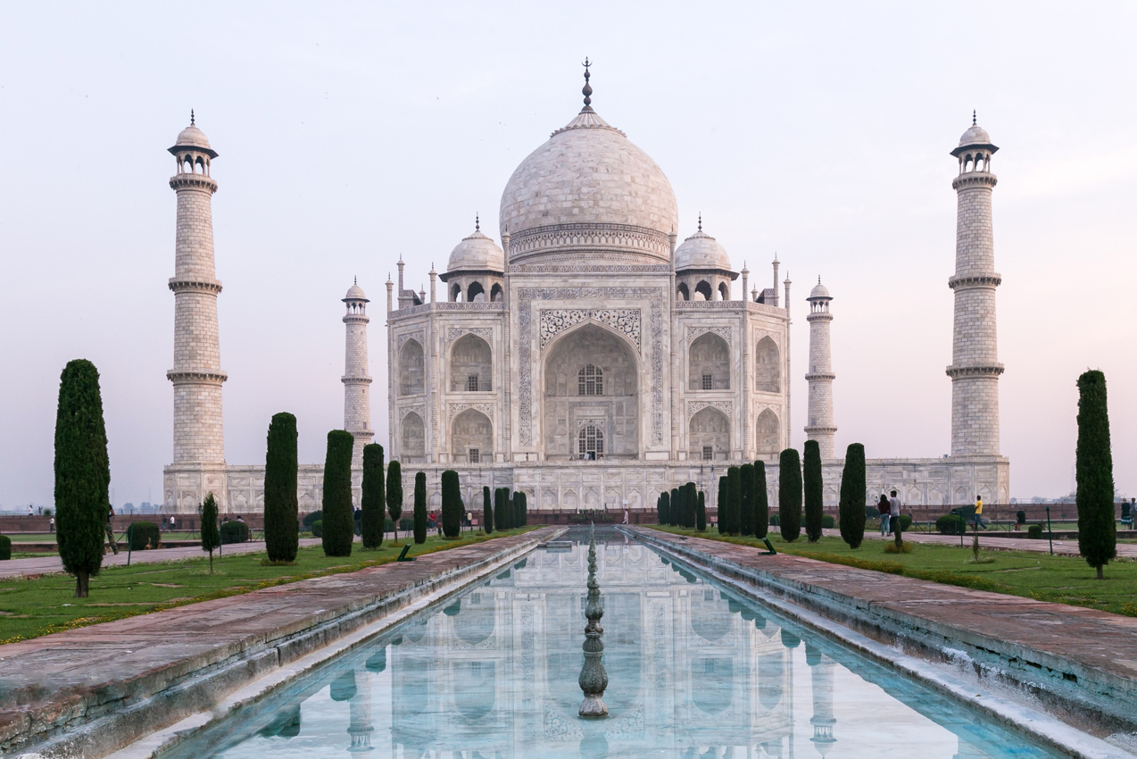
Taj Mahal Mausoleum, India 1648 AD

Slide 69
The palace of Versailles, France completed 1682 AD

Slide 70
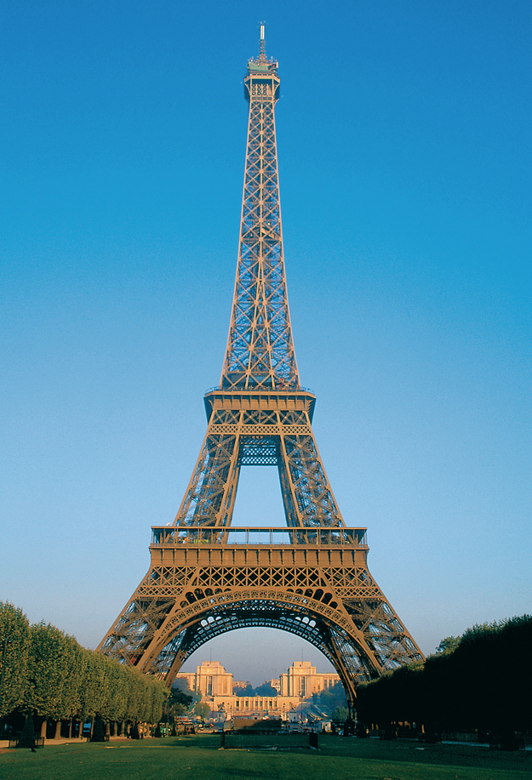
Eiffle Tower, Paris, France completed 1889 AD

Slide 71
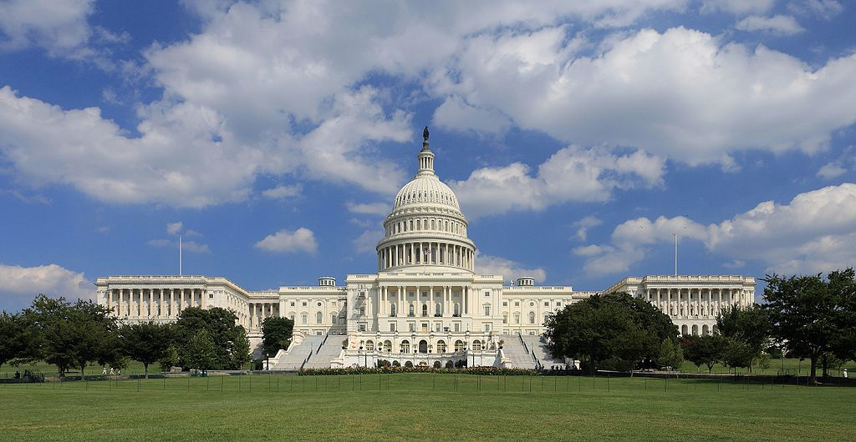
United States Capitol Building, Neoclassic style,
Washing DC, USA 1800 AD

Slide 72
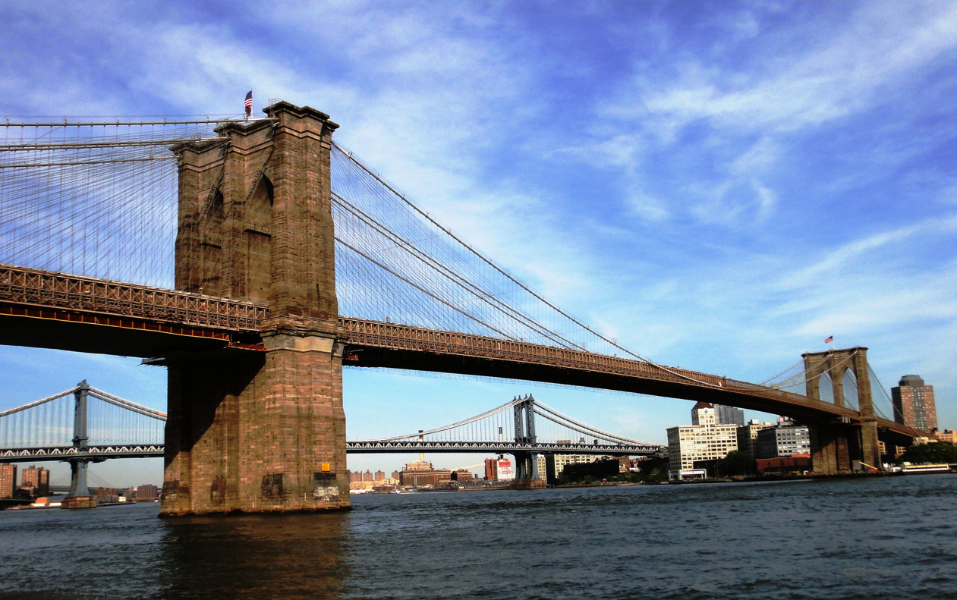
Brookland Bridge, New York City, New York, USA 1883 AD

Slide 73
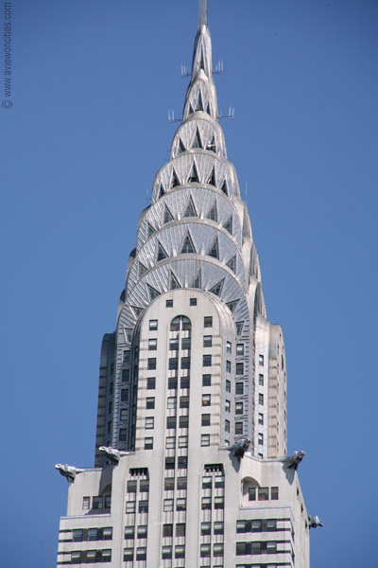
Chrysler Building, Art Deco style, New York Ctiy, New York, USA 1930 AD

Slide 74
Goden Gate Bridge, San Franciso, California, USA 1937 AD

Slide 75
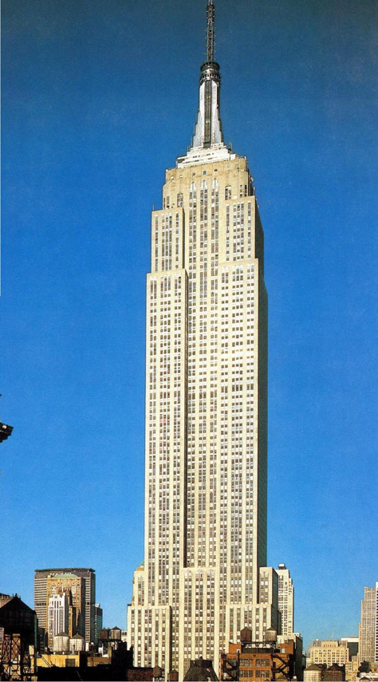
Empire State Building, skeleton and skin architure, Art Deco style, New York Ctiy, New York, USA 1931 AD

Slide 76
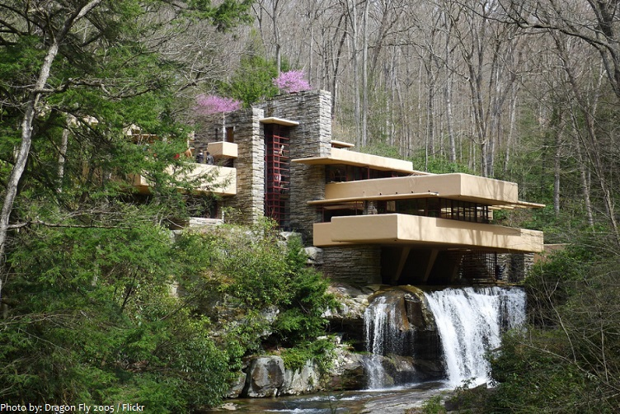
Falling Water home, by Frank Lloyd Wright,
cantilever extensions, rural Pennsylvania, USA 1935

Slide 77
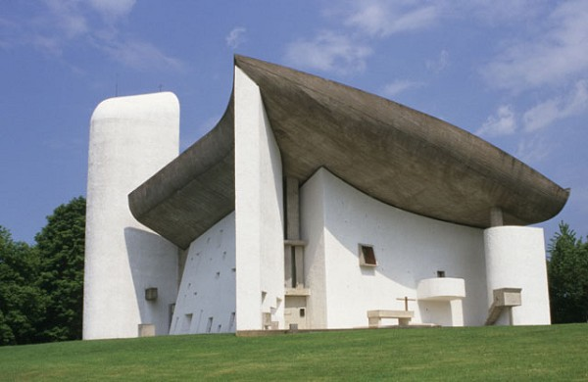
Notre Dame du Haut, by Le Corbusier,
Ronchamp, France1955

Slide 78
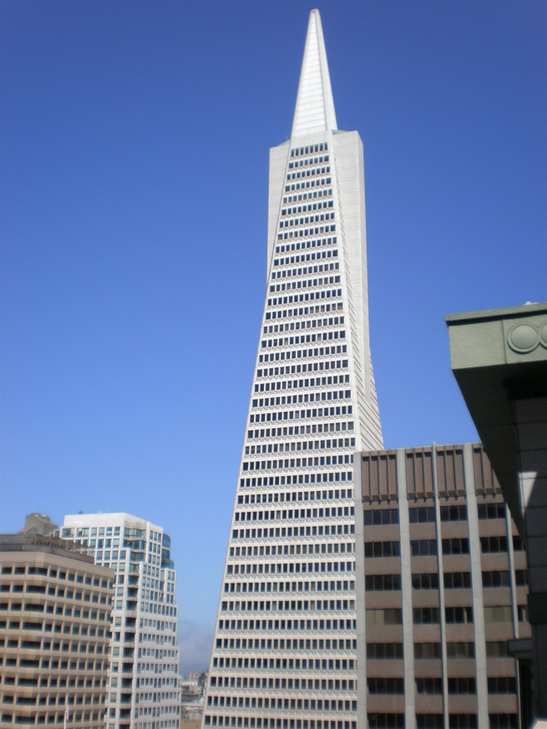
Transamerica Buildig, skeleton and skin architure, San Francisco, California, USA 1972

Slide 79
Gateway Arch, Saint Louis, Missouri, USA 1965

Slide 80
The Burj Al Arab Hotel, skeleton and skin architecture,
by Tom Wills-Wright, Dubai, United Arab Emirates, 1999 AD

Slide 81
Walt Disney Concert Hall, shell architecture, by Frank Ghery. Los Angeles, California USA 2003

Slide 82
Sydney Opera House, shell architecture, by Danish architect Jorn Utzon, Sydney, Austrailia 1973

Slide 83
Ifly Dubai Building, Dubai 2010

Slide 84
Moshe Safdie’s Habitat 1967
Cliff Palace, Mesa Verde ancestral indians cliff dwelling, Southwest Colorado, USA cir 1260 AD

Slide 85
Crafts
ARTS 1301.05 James Cost

Slide 86
Crafts The many so-called “craft” media—ceramics, glass, fiber, metal, and wood in particular—have traditionally been distinguished from the fine arts because they are employed to make functional objects, from the utensils with which we eat to the clothes we wear. In the hands of an artist, however, these media can be employed to make objects that are not only of great beauty but that also must be appreciated as works of art in their own right.

Slide 87
Crafts The crafts are works of expert handiwork or craftsmanship, done by the maker’s own hand with extraordinary skill. But despite the fact that painters and sculptors and printmakers are all expert with their hands as well, we don’t call their work “craft.” Indeed, many artists feel insulted if their work is described as being “craftful.” These artists probably feel that a craft must be functional. But the distinction between craft and artwork is not that clear-cut. Perhaps the only meaningful distinction we can draw between art and craft is this: If a work is primarily made to be used, it is craft, but if it is primarily made to be seen or experienced, it is art. However, the maker’s intention may be irrelevant. If you buy an object because you enjoy looking at it, then whatever its usefulness, it is, for you at least, a work of art.

Slide 88
Ceramics These are objects that are formed out of clay and then hardened by firing, or baking in a very hot oven, called a kiln (see Chapter 12). Ceramic objects are generally either flat and relieflike (think of a plate or a square of tile), or hollow, like cast sculpture (think of a pitcher). Unlike metal casts, the hollowness of ceramic objects is not a requirement of weight or cost as much as it is of utility (ceramic objects are made to hold things), and of the firing process itself. Solid clay pieces tend to hold moisture deep inside, where it cannot easily evaporate, and during firing, as this moisture becomes super-heated, it can cause the object to explode. In order to make hollow ceramic objects, a number of techniques have been developed. Ceramics Video

Slide 89
Ceramics Most ceramic objects are created by one of three means—slab construction, coiling, or throwing on a potter’s wheel, as discussed below. Pieces made by any one of these techniques are then painted with glazing. Ceramic glazes consist of powdered minerals suspended in water, which are applied to the object after the first firing. When the object is fired a second time, the minerals dissolve and fuse into a glassy, nonporous coating that bonds to the ceramic clay. Glazes serve many purposes. They were probably first created to seal clay vessels, which might otherwise absorb food or drink, thus stimulating the growth of bacteria (if in the ancient world the existence of bacteria per se was unknown, the odor they produced was well understood). But the chemical reaction of firing the glaze also produces colors, and these colors have become an important aesthetic element in the creation of ceramics as works of art.

Slide 90
Colling María Martinez’s black jar is an example of a second technique often used in ceramic construction, coiling, in which the clay is rolled out in long, ropelike strands that are coiled on top of each other. As the potter builds the coils up in a continuous spiral, each strand is smoothed and blended one to the next, eliminating any trace of the original ropes of clay and making pot walls of uniform thickness. Before firing, the pot is burnished or polished to a high gloss, usually with a stone.

Slide 91
This pot is a specific example of a technique developed by María and her husband, Julián, in about 1919 at San Ildefonso Pueblo, 20 miles northwest of Santa Fe, New Mexico. The red clay pot was smoothed to an extreme sheen and then a design was painted on it with liquid clay—a slip, as it is known. The pot was smothered in dung part way through the firing, the resulting smoke blackening the clay, the areas painted with the slip remaining matte, or dull, and the other areas taking on a highly glossed, shiny finish. So distinctive was María’s style that she was encouraged to sign her pots, becoming the first potter in the Southwest to do so and thus leading the way to the acceptance of Native American pottery as a fine art.

Slide 92
There are three basic types of ceramics Earthenware, made of porous clay and fired at low temperatures, must be glazed if it is to hold liquid. Stoneware is impermeable to water because it is fired at high temperatures, and it is commonly used for dinnerware today. Finally, porcelain, fired at the highest temperatures of all, is a smooth-textured clay that becomes virtually translucent and extremely glossy in finish during firing.

Slide 93
Glassware Since ancient times, glassware was made either by forming the hot liquid glass, made principally of silica, or sand, mixed with soda ash, on a core or by casting it in a mold. The invention of glassblowing techniques late in the first century bce so revolutionized the process that, in the Roman world, glassmaking quickly became a major industry. To blow glass, the artist dips the end of a pipe into molten glass and then blows through the pipe to produce a bubble. While it is still hot, the bub ble is shaped and cut. Glass Blowing Video

